Slide 1


Project Name: Clinic Booking System Subtitle: Java Application Project by:Nirere Angelique
IHUMURE CLINICS

Slide 2
MY PROBLEM STATEMENT
Problem Statement
Manual clinic management is inefficient:The old way is holding us back. We are wasting resources. We need a smarter, digital tool to run things smoothly.
Need digital appointment system:we need digital because not taking long time for waiting,frustration for both patient and doctors
Paper-based records are hard to manage:"We're trying to run a modern healthcare service with a library system from 100 years ago. We spend more time finding and moving paper than actually helping patients.

Slide 3
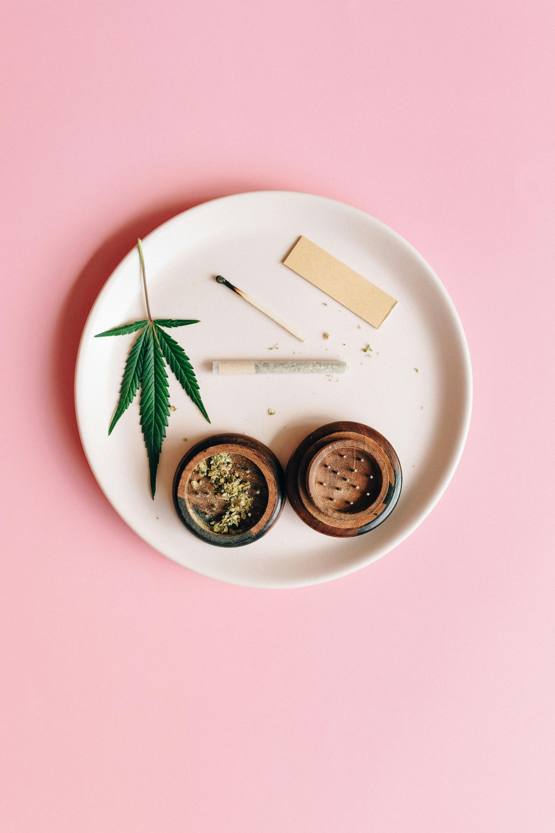
let’s see our solution
Solution
Java console application: is a program that runs entirely in the command line or terminal—no fancy windows, buttons, or mouse clicks. Everything happens through text input and output.
Manages doctors, patients, appointments
User-friendly menu system: is like a well-designed clinic menu that helps patients find exactly what they want without confusion or frustration

Slide 4
ACTIVITY DIAGRAM
Activity Diagram
Copy Diagram 1 from DIAGRAMS.md
┌─────────────────────────────────────────────────────────────┐
│ PATIENT BOOKING ACTIVITY FLOW │
└─────────────────────────────────────────────────────────────┘
┌─────────┐ ┌──────────────┐ ┌──────────────┐
│ START │────▶│ View Doctors │────▶│ Select Doctor│
└─────────┘ └──────────────┘ └──────────────┘
│
▼
┌─────────┐ ┌──────────────┐ ┌──────────────┐
│ ERROR │◀────│Enter Patient │◀────│Choose Patient│
│ Handler │ │ Details │ │ │
└─────────┘ └──────────────┘
│ │
▼ ▼
[Invalid Data] [Patient Not Found]
│ │
└──────────┬─────────────┘
▼
┌────────────────────┐
│ Select Appointment │
│ Type │
└────────────────────┘
│
▼
┌────────────────────┐
│ Enter Date/Time │
│ & Reason │
└────────────────────┘
│
▼
┌────────────────────┐
│ Confirm Booking │
│ │
└────────────────────┘
│
▼
┌────────────────────┐
│ Save Appointment │
│ (Repository) │
└────────────────────┘
│
▼
┌────────────────────┐
│ Generate Confirmation│
│ (Factory Pattern) │
└────────────────────┘
│
▼
┌────────────────────┐
│ Send Notification │
│ (Observer Pattern)│
└────────────────────┘
│
▼
┌─────┐
│ END │
└─────┘
Title: "User Activity Flow"

Slide 5
DATA FLOW DIAGRAM
Data Flow Diagram
Copy Diagram 2 from ┌─────────────────────────────────────────────────────────────────────┐
│ CLINIC BOOKING SYSTEM - DFD LEVEL 1 │
└─────────────────────────────────────────────────────────────────────┘
┌─────────────────┐ Patient Data ┌─────────────────┐
│ │─────────────────────────────▶│ │
│ │ │ │
│ PATIENT │ Doctor List │ DATABASE │
│ │◀─────────────────────────────│ (In-Memory) │
│ │ │ │
└─────────────────┘ Appointment Data └─────────────────┘
│ ▲ │
│ │ │
│ Patient Info │ │Appointment
│ Doctor Selection │ │Records
│ Time/Date │ │
│ Reason │ ▼
▼ │ ┌─────────────┐
┌─────────────────────────────────────────────────┐ │ │ │
│ │ │ │ REPORTS & │
│ BOOKING PROCESS │──┘ │ ANALYTICS │
│ (Main Controller) │ │ │
│ │ └─────────────┘
└─────────────────────────────────────────────────┘ ▲
│ ▲ │
│ │ │
│ │ │Booking
│ │ │Statistics
▼ │ │
┌─────────────────┐ Error Messages │ │
│ │◀────────────────────────────────┘ │
│ │ │
│ VALIDATION & │ Success Messages │
│ ERROR HANDLER │────────────────────────────────────────────┘
│ │
└─────────────────┘
│
│ Validated Data
▼
┌─────────────────┐
│ │
│ NOTIFICATION │───────▶ SMS/Email to Patient
│ SYSTEM │───────▶ Alert to Doctor
│ (Observer) │───────▶ System Logs
│ │
└─────────────────┘DIAGRAMS.md
Title: "System Architecture"

Slide 6
SEQUENCE DIAGRAM
Sequence Diagram
Copy Diagram 3 from DIAGRAMS.md
┌───────────┐ ┌──────────┐ ┌─────────────┐ ┌──────────────┐ ┌─────────────────┐
│ Patient │ │ Main │ │ Patient │ │ Doctor │ │ Appointment │
│ (User) │ │ (Controller)│ │ Repository │ │ Repository │ │ Repository │
└─────┬─────┘ └─────┬────┘ └──────┬──────┘ └──────┬───────┘ └────────┬────────┘
│ │ │ │ │
│ 1. Start Booking│ │ │ │
│────────────────▶│ │ │ │
│ │ │ │ │
│ │ 2. Get Doctors │ │ │
│ │─────────────────▶ │ │
│ │ │ │ │
│ │ │ 3. Return Doctors│ │
│ │◀────────────────│ │ │
│ │ │ │ │
│ 4. Select Doctor│ │ │ │
│────────────────▶│ │ │ │
│ │ 5. Find Doctor │ │ │
│ │────────────────────────────────────▶ │
│ │ │ │ │
│ │ │ 6. Return Doctor │ │
│ │◀──────────────────────────────────── │
│ │ │ │ │
│ 7. Select Patient│ │ │ │
│────────────────▶│ │ │ │
│ │ 8. Find Patient │ │ │
│ │────────────────▶│ │ │
│ │ │ │ │
│ │ │ 9. Return Patient│ │
│ │◀────────────────│ │ │
│ │ │ │ │
│10. Enter Details│ │ │ │
│────────────────▶│ │ │ │
│ │ │ │ │
│ │11. Create Appt │ │ │
│ │ (Factory) │ │ │
│ │───────┐ │ │ │
│ │ │ │ │ │
│ │ │12. Save Appointment │ │
│ │ └───────────────────────────────────────────────▶│
│ │ │ │ │
│ │ │ │13. Appointment Saved│
│ │ │ │◀───────────────────│
│ │ │ │ │
│ │14. Send Notification │ │
│ │ (Observer) │ │ │
│ │───────┐ │ │ │
│ │ │ │ │ │
│ │ │15. Confirmation Message │ │
│◀───────────────────────┘ │ │ │
│ │ │ │ │
┌─────┴─────────┐ ┌─────┴──────┐ ┌───────┴────────┐ ┌───────┴─────────┐ ┌────────┴──────────┐
│ Patient │ │ Main │ │ Patient │ │ Doctor │ │ Appointment │
│ (User) │ │(Controller)│ │ Repository │ │ Repository │ │ Repository │
└───────────────┘ └────────────┘ └────────────────┘ └─────────────────┘ └───────────────────┘
Title: "Appointment Booking Sequence"

Slide 7
Features
Features
List features (use bullet points) is like a clinic menu for your software. It tells users (and developers) exactly what the system can do. Each bullet point is a specific capability or function.
Show technologies used (Java, Git, etc.):When we say "technologies used" in a software project, we're talking about the tools, languages, and platforms we need to build and run the system

Slide 8
GitHub Repository
Show your GitHub link: https://github.com/AngelNirere/ClinicBookingSystem
Show code structure screenshot

Slide 9

let’s see together our final toughts
Conclusion
Working application completed
All requirements met
Future improvements possible:Here's what we could add later to make this even better." It's like building a basic house first, then adding extra rooms, a garden, and smart features later.

